Slide 1





Functions in MySql
An Overview of Built-in MySQL Functions

Slide 2


biuguigunibhiu
Introduction
A function in MySQL is a tool that gives a result based on input values.
It helps to change, calculate, or format data in a query.
Functions make our queries shorter, easier to understand, and more powerful.

Slide 3




1
3
2
4
String Functions
Date and Time Functions
Numeric Functions
Aggregate Functions
TYPES OF MYSQL FUNCTIONS

Slide 4

STRING FUNCTIONS
WORK ON TEXT
EXAMPLE:- CONCAT(),UPPER(),LOWER(),REVERSE(),LENGTH()

Slide 5
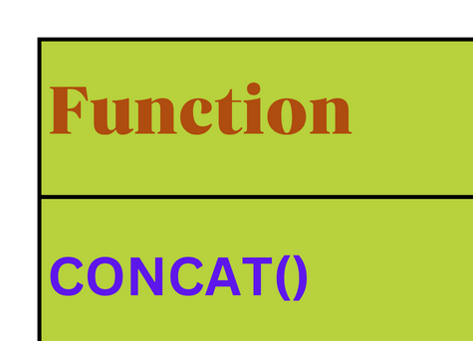

Slide 6

NUMERIC FUNCTIONS
WORK ON NUMBERS
Example:-GREATEST()
LEAST(),POWER()/POW(),SQRT(),RAND()

Slide 7
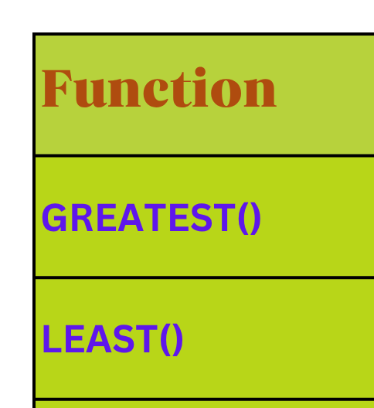

Slide 8


DATE AND TIME FUNCTIONS
WORK ON DATE/TIME VALUES
Example:-
CURDATE() / CURRENT_DATE(),
NOW() / SYSDATE(),
CURTIME() / CURRENT_TIME(),
DAYNAME(),
MONTHNAME()

Slide 9
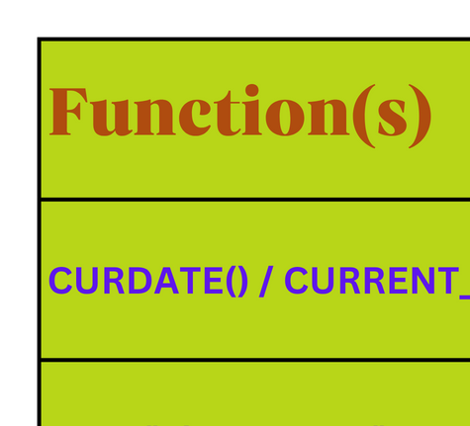

Slide 10


AGGREGATE FUNCTIONS
USED WITH GROUPS OF DATA
Example:- SUM(),AVG(),COUNT(),MAX(),MIN()

Slide 11
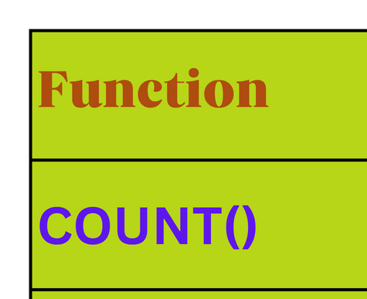

Slide 12





Slide 13




Thank You

